Slide 1
DUBAI-BASED / PVP-FIRST / PRE-SEED
THE ASK
Browser games become
wallet-native PvP matches.
$1.5M
12 months to one compliant market launch
Eight playable games, STAK on iOS, wallet connection, matchmaking, and server-verified results already exist.
PROPOSED STRUCTURE
Pre-seed equity financing
Target 10-15% dilution*
*Subject to the lead investor, final entity, instrument, and counsel.
PROJECT HOUSE/01 / WORKING TITLE
Notes:
[Sources]
- Management-provided meeting transcript and corrected call notes, August 2026.
- Local ReachFi investor-demo repository and product assets.

Slide 2
WHY THIS PRODUCT
Start with PvP.
Add house exposure later.
PLAYER-FUNDED PVP
The platform earns for matching, verifying, settling, and retaining both players.
The launch wedge is short, competitive browser games the company controls - not a catalog of the same casino titles every operator can source.
01
No app download for web play
02
One deterministic run for both players
03
Server replays the submitted inputs
04
No game-result balance-sheet exposure
Payment, refund, fraud, liquidity, and operating risks still remain.
PROJECT HOUSE/01 / PRIVATE PRE-SEED BRIEF
02
Notes:
[Sources]
- Management-provided product architecture and live demo behavior.
- Risk qualifier written for this deck; not a legal or actuarial opinion.

Slide 3
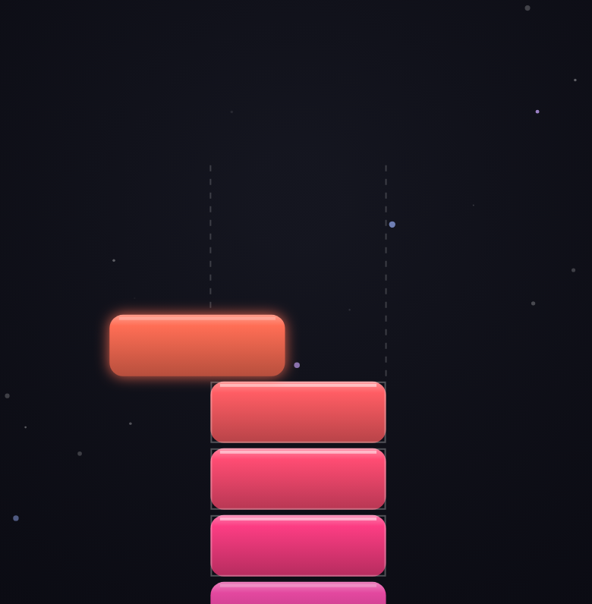

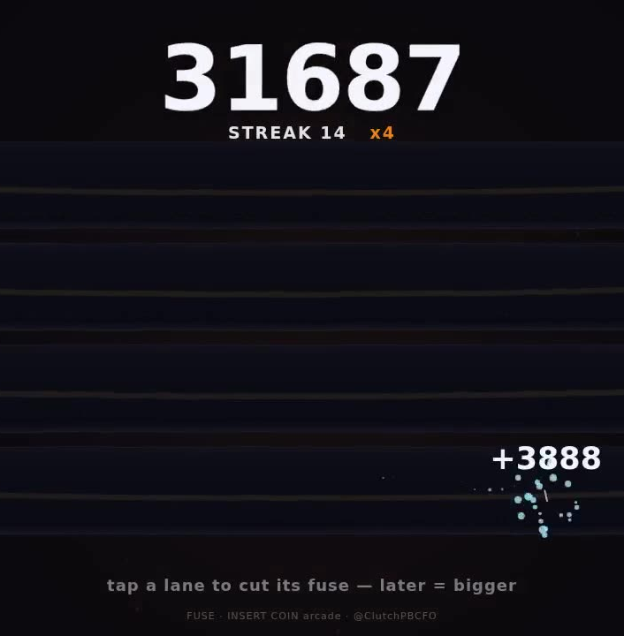
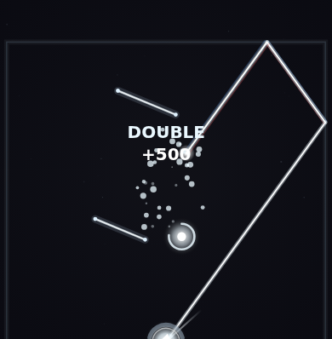
SHIPPED PRODUCT
The product base is live.
STAK DUEL
PULSE
FUSE
PRISM
Live browser 1v1
Live worker-backed game
Live worker-backed game
Live worker-backed game
08
browser-playable games
04
games on the shared Arena worker
iOS
STAK on the App Store
PROJECT HOUSE/01 / PRIVATE PRE-SEED BRIEF
03
Notes:
[Sources]
- Local assets: public/assets/reachfi-stak.png, reachfi-pulse.png, reachfi-fuse.jpg, and reachfi-prism.png.
- STAK App Store listing: https://apps.apple.com/us/app/stak-tower-stack-game/id6775574900
- Management-provided product count and worker coverage; verify again in technical diligence.

Slide 4
THREE-MINUTE INVESTOR DEMO
Connect. Sign. Match. Play. Verify.
01
02
03
04
05
06
Connect
Sign
Match
Play
Verify
Settle
EVM wallet or WalletConnect
No-value session challenge
Choose STAK DUEL
Same deterministic run
Worker replays both logs
Enabled only after launch gates
PRODUCT TRUTH
The wallet signature and game result are real. The money is not.
No transaction / No approval / No deposit
PROJECT HOUSE/01 / PRIVATE PRE-SEED BRIEF
04
Notes:
[Sources]
- Live investor demo behavior in the local ReachFi repository and investors.reachfi.network.
- The demo uses play-money; no transaction, approval, deposit, or withdrawal is requested.

Slide 5
GO-TO-MARKET
The founder duel is the acquisition creative.
EXISTING DISTRIBUTION
14K+
01
Challenge
Play creators, investors, and community members live.
X audience
02
Clip
Turn wallet-to-result proof into short-form content.
7-8M
03
Refer
Every player brings the next opponent.
trailing 12-month impressions
04
Measure
Track activation, replay, retention, and funded-player cost.
Management-reported; analytics available in diligence.
PROJECT HOUSE/01 / PRIVATE PRE-SEED BRIEF
05
Notes:
[Sources]
- Audience and impression figures from project operating context, current as of June-August 2026; management analytics should be provided in diligence.
- Acquisition loop is the proposed launch strategy, not a historical performance claim.

Slide 6
ILLUSTRATIVE PVP UNIT ECONOMICS
Revenue follows verified match volume.
MONTHLY ENTRY VOLUME
PLANNING TAKE RATE
GROSS PLATFORM REVENUE
$1.0M
12%
$120K
x
=
Illustrative bridge, not a forecast. Net revenue deducts payment costs, promotions, chargebacks, refunds, fraud, incentives, taxes, compliance, and market duties.
CORE RISK DISTINCTION
No game-result house exposure in player-funded PvP.
PROJECT HOUSE/01 / PRIVATE PRE-SEED BRIEF
06
Notes:
[Sources]
- Planning take rate supplied for the investor model; no historical real-money revenue is claimed.
- Risk qualifier written for this deck; not a forecast, legal opinion, or guarantee.

Slide 7
COMPETITIVE POSITION
Own the PvP workflow, not just the casino skin.
CATEGORY
WHAT IT DOES WELL
STRUCTURAL GAP
Crypto casinos
Liquidity, catalog, affiliates
Commodity games and house-led risk
Skill-gaming apps
Competitive behavior
App-first, fiat-first, closed identity
Web3 game portals
Wallet-native access
Weak match and verification workflow
HOUSE/01 wedge
Browser + wallet + owned PvP stack
Must prove compliance and repeat play
The differentiation is specific. The remaining proof burden is equally specific.
PROJECT HOUSE/01 / PRIVATE PRE-SEED BRIEF
07
Notes:
[Sources]
- Competitive categories are a management positioning framework, not independently researched market-share claims.
- A named competitor set and customer interviews belong in the private data room before broad outreach.

Slide 8
TEAM AND OWNERSHIP
Separate the operator from the technology.
OWNER / OPERATING LEAD
PRODUCT AND GROWTH
TRANSACTION CONDITION
Dubai-based principal
Christian 'Clutch'
Close before capital
Operating-company formation, fundraising mandate, regulator-facing decision, and signing authority.
Built the ReachFi games and Arena workflow. Former eight-year operating-business owner; product, delivery, and distribution.
Entity, cap table, vesting, governance, CEO authority, and ReachFi licence or assignment must be signed.
Identity, title, cap table, and signed authority are disclosed in private diligence - never implied by the deck.
PROJECT HOUSE/01 / PRIVATE PRE-SEED BRIEF
08
Notes:
[Sources]
- Founder and operating-role descriptions from the management meeting transcript and project brief.
- The Dubai principal's legal identity, title, cap table, and signing authority must be supplied in the private data room before circulation.

Slide 9
$1.5M / 12 MONTHS
Capital buys one compliant launch attempt.
Regulatory, legal and entity
$200K
GATE-BASED MILESTONES
Product, payments and data
$300K
0-90
Entity / IP / counsel route
Compliance, security and testing
$225K
Payments / KYC / controls / testing
91-180
Team, support and operations
$350K
181-270
Closed cohort / retention / fraud baseline
Launch and player acquisition
$250K
Working capital and contingency
$175K
271-365
First compliant market if every gate clears
No value play before the required licence and controls.
PROJECT HOUSE/01 / PRIVATE PRE-SEED BRIEF
09
Notes:
[Sources]
- Use-of-funds allocation is the current management plan and totals $1.5M.
- Milestone dates are operating targets subject to licence, vendor, counsel, and financing dependencies.

Slide 10
THE NEXT MEETING
DECISION
Play the founder.
Then diligence the company.
$1.5M
Pre-seed equity financing
First three minutes: wallet connection and live STAK duel. Next twenty: ownership, licensing, acquisition economics, the $1.5M plan, and the conditions required before value play.
01
Dubai-based operating company
02
12-month funded plan
03
Target 10-15% dilution*
04
No token launch in the round
*Subject to definitive documents and counsel.
investors.reachfi.network
Notes:
[Sources]
- Proposed round structure and demo flow from the August 2026 management plan.
- This deck is not an offer; final terms require definitive documents and counsel.

